Slide 1
Image Captioning
Explore ML
Notes:
In this session, we are going to combine to combine text and image classification techniques to create a very powerful application of machine learning. Different kinds of systems can be connected like a pipeline.
We've discussed how machine learning requires large amounts of data and this task involves downloading a large dataset of images. We will open the notebook and discuss the topic after it begins to download.

Slide 2

Text Classification Coding Activity
https://www.tensorflow.org/beta/tutorials/text/image_captioning
Open the exercise in Colab
Sign in with your Google account
Activate the Runtime
Run code
Notes:
Go to the exercise notebook
Open the exercise in Colab, a browser based notebook for running code in the cloud without needing to setup your computer.
Sign into your Google account (if it is their own account they can save the notebook in Drive to refer to later)
Activate the cloud-based runtime so you can run code in the cloud rather than setting up your machine
Run the code in a cell by clicking on the play/triangle button.

Slide 3
Import all libraries
from __future__ import absolute_import, division, print_function, unicode_literals
!pip install tensorflow-gpu==2.0.0-beta0
import tensorflow as tf
from tensorflow import keras
from sklearn.model_selection import train_test_split
from sklearn.utils import shuffle
import re
import numpy as np
import os
import time
import json
from glob import glob
from PIL import Image
import pickle
Notes:
In this activity we will use a GPU. Machine learning algorithms are built on calculus and linear algebra. GPUs or graphic processing units are typically used for video games and similar graphic intensive tasks. GPUs are optimized for these types of calculations rather than the typical CPUs.
Sci-kit learn is another helpful library like TensorFlow and Keras for machine learning tasks. As the machine learning community evolves, these frameworks are interoperating more and more.

Slide 4
Download the MS-COCO Dataset
annotation_zip = tf.keras.utils.get_file('captions.zip',
cache_subdir=os.path.abspath('.'),
origin = 'http://images.cocodataset.org/annotations/annotations_trainval2014.zip',
extract = True)
annotation_file = os.path.dirname(annotation_zip) + '/annotations/captions_train2014.json'
name_of_zip = 'train2014.zip'
if not os.path.exists(os.path.abspath('.') + '/' + name_of_zip):
image_zip = tf.keras.utils.get_file(name_of_zip, cache_subdir=os.path.abspath('.'),
origin = 'http://images.cocodataset.org/zips/train2014.zip', extract = True)
PATH = os.path.dirname(image_zip) + '/train2014/'
else:
PATH = os.path.abspath('.') + '/train2014/'
Notes:
Note this code will attempt to download a 13Gb file. Consider your download speed (~60 minutes on a 3G Network) and potential charges.
MS-COCO = Microsoft Common Objects in Context. Similar to an image classifier model but it identifies objects in a photo which will be useful for our task.
This should take approximately 10 minutes so let's review and discuss this task while the data is downloading.

Slide 5
Review
What are three important things you’ve learned in this course? Share them with a partner.
What are the basic, high-level steps to follow when creating a machine learning project?

Slide 6
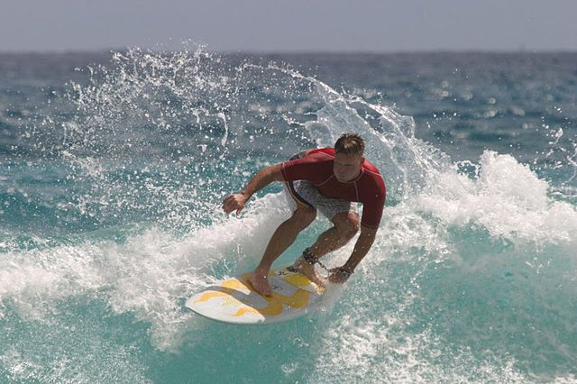
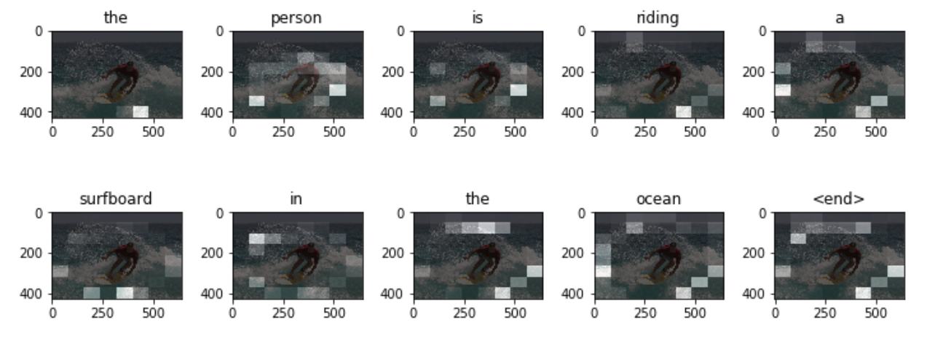
Attention-based ML
The person is riding a surfboard in the ocean.
Notes:
In this lab, you will build and test an ML model that creates captions from a corpus of images and associated text.
Ask learners what the ML system will need to do in order to caption the image?
Identify images in the image
Identify what the focus/background is
Determine how the objects are interacting with one another
Translate these insights into a sentence.
[Click to show attention-based] image.
Our model will need to not only identify objects in an image but also identify their relationship with one another.
Image from TensorFlow tutorial

Slide 7
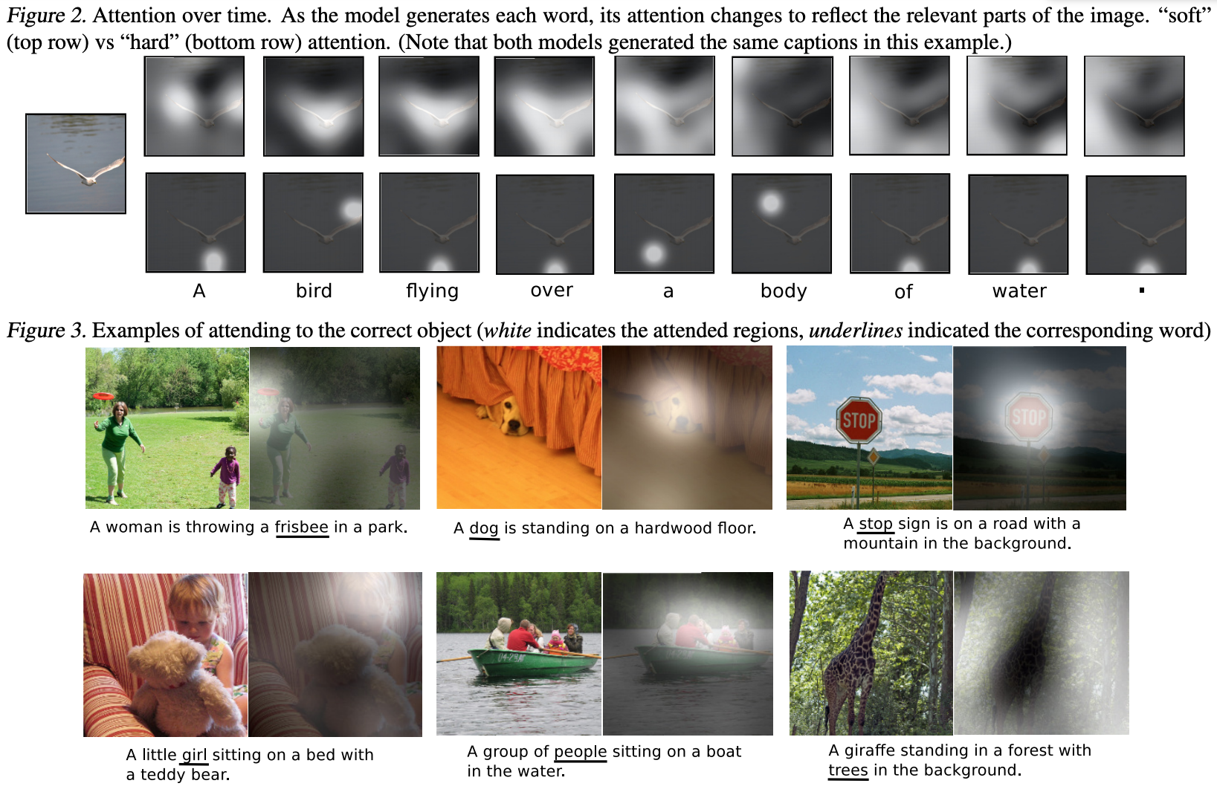
Attention-based ML
Images from Show, Attend and Tell,
Xu, K., et. al. (2016)
Notes:
In order to identify multiple objects and their relationship with one another we will use an approach called attention-based ML.
This means the ML model can focus its “attention” on specific parts of the image that it judges to be important, instead of analyzing the entire image. The model in the lab focuses attention on a different part of the image for each word in the caption. Depicted below is a visual representation of the model’s areas of attention at each step. When you finish this lab, you will have a similar representation.
If learners would like to learn more, read the paper on the model this lab is based on (also cited in slide).
Image from TensorFlow tutorial

Slide 8
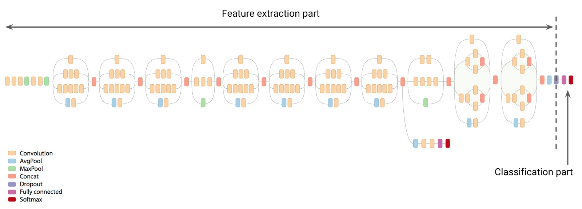
Inception Classification Model
Edges
High-level Features
Apple
Face
Pizza
Shoe
Tree
...
:0:30
:0.95
:0.30
:0.00
:0.00
Shapes
Notes:
Inception is an image classification model trained from 1000s of images from the ImageNet challenge dataset.
The input is an image and the output are labels the model predicts for the image.
For this activity we are only using the top convolutional layer of the model which makes the high-level predictions. Just like the other activities, we're going to retrain this model for our task.
Image from Google

Slide 9
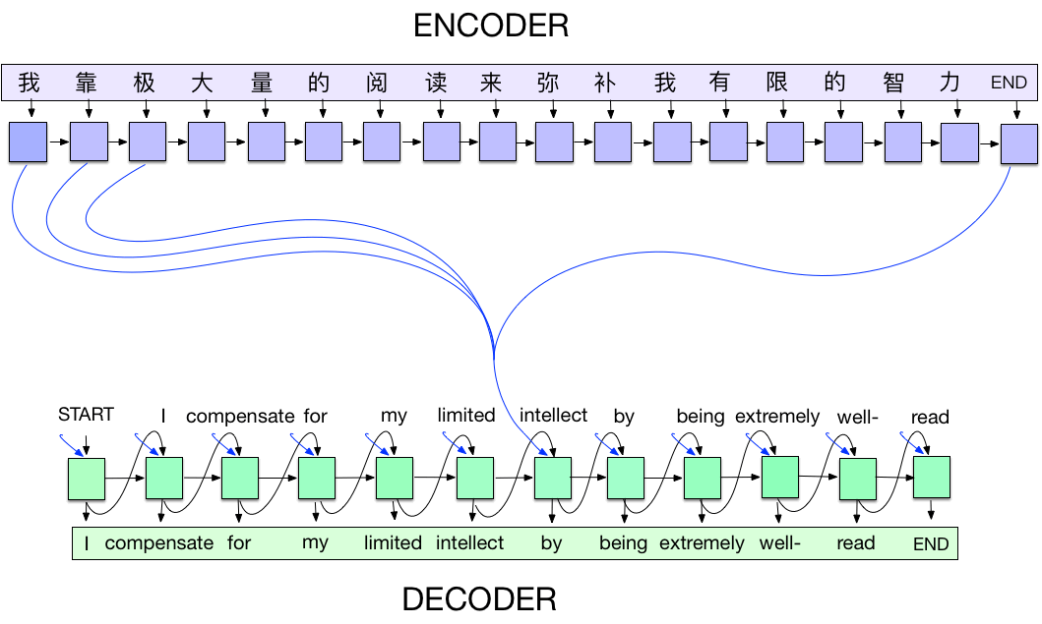
Sequence Model
Notes:
This lab uses an encoder-decoder ML model (also called a sequence to sequence model) to perform image captioning. It is identical to the model used in translation from one language to another. As far as the computer is concerned translating from images to text is another language.
Here is a diagram of the encoder-decoder model applied to language translation.
Each input word is assigned a weight by the attention mechanism, which is then used by the decoder to predict the next word in the sentence.
You can think of image captioning as a form of translation, from image to text instead of from one language to another.
Image from Google

Slide 10
STOP
Do not present the following slides as a lecture.
They are for questions or a debrief after the activity.
Let learners work through the activity in pairs.
Notes:
Once the MS-COCO data is downloaded, learners should proceed in groups at their own pace.

Slide 11
Optional: Limit the size of the training set (1 of 3)
with open(annotation_file, 'r') as f:
annotations = json.load(f)
all_captions = []
all_img_name_vector = []
for annot in annotations['annotations']:
caption = '<start> ' + annot['caption'] + ' <end>'
image_id = annot['image_id']
full_coco_image_path = PATH + 'COCO_train2014_' + '%012d.jpg' % (image_id)
all_img_name_vector.append(full_coco_image_path)
all_captions.append(caption)
Notes:
To speed up training time, you’ll use only 30,000 of the images and captions. Using more data would improve the accuracy of the model.

Slide 12
Optional: Limit the size of the training set (2 of 3)
train_captions, img_name_vector = shuffle(all_captions,
all_img_name_vector,
random_state=1)
num_examples = 30000
train_captions = train_captions[:num_examples]
img_name_vector = img_name_vector[:num_examples]
Notes:
To speed up training time, you’ll use only 30,000 of the images and captions. Using more data would improve the accuracy of the model.

Slide 13
Optional: Check the training set size (3 of 3)
len(train_captions), len(all_captions)
(30000, 414113)
Notes:
Check that you have successfully limited the size of the training set.

Slide 14
Preprocess the Images
def load_image(image_path):
img = tf.io.read_file(image_path)
img = tf.image.decode_jpeg(img, channels=3)
img = tf.image.resize(img, (299, 299))
img = tf.keras.applications.inception_v3.preprocess_input(img)
return img, image_path
Notes:
Use InceptionV3 (which is pretrained on Imagenet) to classify each image. You will extract features from the last convolutional layer.
First, convert the images into InceptionV3's expected format by:
Resizing the image to 299px by 299px.
Preprocess it using the preprocess_input method to normalize the image so that it contains pixels in the range of -1 to 1, which matches the format of the images used to train InceptionV3.

Slide 15
Initialize InceptionV3 and load the pretrained Imagenet weights
image_model = tf.keras.applications.InceptionV3(include_top=False,
weights='imagenet')
new_input = image_model.input
hidden_layer = image_model.layers[-1].output
image_features_extract_model = tf.keras
.Model(new_input, hidden_layer)
Notes:
Create a tf.keras model where the output layer is the last convolutional layer in the InceptionV3 architecture. The shape of the output of this layer is 8x8x2048.
You use the last convolutional layer because this example is about attention. You don't perform this initialization during training because it could become a bottleneck.
This code
Forwards each image through the network and stores the resulting vector in a dictionary (image_name --> feature_vector).
Saves the dictionary to disk after all the images are passed through the network.

Slide 16
Cache the extracted features
encode_train = sorted(set(img_name_vector))
image_dataset = tf.data.Dataset.from_tensor_slices(encode_train)
image_dataset = image_dataset.map(load_image, num_parallel_calls=tf.data.experimental.AUTOTUNE).batch(16)
for img, path in image_dataset:
batch_features = image_features_extract_model(img)
batch_features = tf.reshape(batch_features, (batch_features.shape[0], -1,
batch_features.shape[3]))
for bf, p in zip(batch_features, path):
path_of_feature = p.numpy().decode("utf-8")
np.save(path_of_feature, bf.numpy())
Notes:
You will pre-process each image with InceptionV3 and cache the output to disk. Although it would be faster to store this in Colab's cache it is too large. Working with large amounts of data requires large amounts of processing power and storage.
The caching will take about 10 minutes to run in Colab with a GPU.

Slide 17
Preprocess and tokenize the captions (1 of 2)
encode_train = sorted(set(img_name_vector))
image_dataset = tf.data.Dataset.from_tensor_slices(encode_train)
image_dataset = image_dataset.map(load_image, num_parallel_calls=tf.data.experimental.AUTOTUNE).batch(16)
for img, path in image_dataset:
batch_features = image_features_extract_model(img)
batch_features = tf.reshape(batch_features, (batch_features.shape[0], -1,
batch_features.shape[3]))
for bf, p in zip(batch_features, path):
path_of_feature = p.numpy().decode("utf-8")
np.save(path_of_feature, bf.numpy())
Notes:
A large portion of your time building a machine learning system involves exploring and pre-processing the data. This code splits up the labeled caption sentences into words forming a dictionary. This process is called tokenization.

Slide 18
Preprocess and tokenize the captions (2 of 2)
top_k = 5000
tokenizer = tf.keras.preprocessing
.text.Tokenizer(num_words=top_k, oov_token="<unk>",
filters='!"#$%&()*+.,-/:;=?@[\]^_`{|}~ ')
tokenizer.fit_on_texts(train_captions)
train_seqs = tokenizer.texts_to_sequences(train_captions)
tokenizer.word_index['<pad>'] = 0
tokenizer.index_word[0] = '<pad>'
train_seqs = tokenizer.texts_to_sequences(train_captions)
cap_vector = tf.keras.preprocessing
.sequence.pad_sequences(train_seqs, padding='post')
max_length = calc_max_length(train_seqs)
Notes:
Unless you are have unlimited resources and time you will need to make decisions to make the best use of both. In this activity, one memory saving decision is limiting the vocabulary size to the top 5,000 words (to save memory) and replaces all other words with the token "UNK" (unknown).

Slide 19
Split the data into training and testing
img_name_train, img_name_val, cap_train, cap_val =
train_test_split(img_name_vector,
cap_vector,
test_size=0.2,
random_state=0)
len(img_name_train), len(cap_train), len(img_name_val), len(cap_val)
(24000, 24000, 6000, 6000)
Notes:
Creating a model involves training the model based on some subset of the data and leaving another portion to validate how well the model does on new data. A common practice is to start with a data split of 80% training and 20% validation.
It's important to scrutinize your data splitting methods to ensure both are similarly distributed.

Slide 20
Create a tf.data dataset for training (1 of 2)
BATCH_SIZE = 64
BUFFER_SIZE = 1000
embedding_dim = 256
units = 512
vocab_size = len(tokenizer.word_index) + 1
num_steps = len(img_name_train)
features_shape = 2048
attention_features_shape = 64
Notes:
The last two variables represent the vector shape extracted from InceptionV3 (64, 2048).
The other variables can be modified if you are running this code on a more/less powerful machine.

Slide 21
Create a tf.data dataset for training (2 of 2)
def map_func(img_name, cap):
img_tensor = np.load(img_name.decode('utf-8') + '.npy')
return img_tensor, cap
dataset = tf.data.Dataset.from_tensor_slices((img_name_train, cap_train))
dataset = dataset.map(lambda item1, item2: tf.numpy_function(
map_func, [item1, item2], [tf.float32, tf.int32]),
num_parallel_calls=tf.data.experimental.AUTOTUNE)
dataset = dataset.shuffle(BUFFER_SIZE).batch(BATCH_SIZE)
dataset = dataset.prefetch(buffer_size=tf.data.experimental.AUTOTUNE)
Notes:
The training pipeline will utilize the CPU for data processing and the GPU for neural network calculations.
This code splits the data so it can be processed in parallel between the CPU and GPU and minimize the amount of idle time on either processor.

Slide 22
Building the model (1 of 7)
class BahdanauAttention(tf.keras.Model):
def __init__(self, units):
super(BahdanauAttention, self).__init__()
self.W1 = tf.keras.layers.Dense(units)
self.W2 = tf.keras.layers.Dense(units)
self.V = tf.keras.layers.Dense(1)
Notes:
The model architecture is inspired by the Show, Attend and Tell paper. Complex architectures like this are developed through experimentation and iteration.
New techniques and approaches emerge from the machine learning research community. In online competitions its common to see different but equally effective approaches.
If learners are interested in learning more details, they can look up the TF/Keras/Python API documentation.

Slide 23
Building the model (2 of 7)
def call(self, features, hidden):
hidden_with_time_axis = tf.expand_dims(hidden, 1)
score = tf.nn.tanh(self.W1(features) +
self.W2(hidden_with_time_axis))
attention_weights = tf.nn.softmax(self.V(score), axis=1)
context_vector = attention_weights * features
context_vector = tf.reduce_sum(context_vector, axis=1)
return context_vector, attention_weights
Notes:
Call function:
features(CNN_encoder output) shape == (batch_size, 64, embedding_dim)
hidden shape == (batch_size, hidden_size)
hidden_with_time_axis shape == (batch_size, 1, hidden_size)
score shape == (batch_size, 64, hidden_size)
context_vector shape after sum == (batch_size, hidden_size)

Slide 24
Building the model (3 of 7)
class CNN_Encoder(tf.keras.Model):
def __init__(self, embedding_dim):
super(CNN_Encoder, self).__init__()
self.fc = tf.keras.layers.Dense(embedding_dim)
def call(self, x):
x = self.fc(x)
x = tf.nn.relu(x)
return x
Notes:
Since you have already extracted the features and dumped it using pickle
This encoder passes those features through a Fully connected layer
shape after fc == (batch_size, 64, embedding_dim)

Slide 25
Building the model (4 of 7)
class RNN_Decoder(tf.keras.Model):
def __init__(self, embedding_dim, units, vocab_size):
super(RNN_Decoder, self).__init__()
self.units = units
self.embedding = tf.keras.layers.Embedding(vocab_size, embedding_dim)
self.gru = tf.keras.layers.GRU(self.units,
return_sequences=True,
return_state=True,
recurrent_initializer='glorot_uniform')
self.fc1 = tf.keras.layers.Dense(self.units)
self.fc2 = tf.keras.layers.Dense(vocab_size)
self.attention = BahdanauAttention(self.units)
Notes:
Since you have already extracted the features and dumped it using pickle
This encoder passes those features through a Fully connected layer
shape after fc == (batch_size, 64, embedding_dim)

Slide 26
Building the model (5 of 7)
def call(self, x, features, hidden):
context_vector, attention_weights = self.attention(features, hidden)
x = self.embedding(x)
x = tf.concat([tf.expand_dims(context_vector, 1), x], axis=-1)
output, state = self.gru(x)
x = self.fc1(output)
x = tf.reshape(x, (-1, x.shape[2]))
x = self.fc2(x)
return x, state, attention_weights
def reset_state(self, batch_size):
return tf.zeros((batch_size, self.units))
Notes:
Call
defines attention as a separate model
x shape after passing through embedding == (batch_size, 1, embedding_dim)
x shape after concatenation == (batch_size, 1, embedding_dim + hidden_size
passing the concatenated vector to the GRU
shape == (batch_size, max_length, hidden_size)
output shape == (batch_size * max_length, vocab)

Slide 27
Building the model (6 of 7)
encoder = CNN_Encoder(embedding_dim)
decoder = RNN_Decoder(embedding_dim, units, vocab_size)
Notes:
The images are encoded into text captions and decoded back into images. We want the model to translate back and forth between the two without losing any information.

Slide 28
Building the model (7 of 7)
optimizer = tf.keras.optimizers.Adam()
loss_object = tf.keras.losses
.SparseCategoricalCrossentropy(from_logits=True,
reduction='none')
def loss_function(real, pred):
mask = tf.math.logical_not(tf.math.equal(real, 0))
loss_ = loss_object(real, pred)
mask = tf.cast(mask, dtype=loss_.dtype)
loss_ *= mask
return tf.reduce_mean(loss_)

Slide 29
Checkpoints
checkpoint_path = "./checkpoints/train"
ckpt = tf.train.Checkpoint(encoder=encoder,
decoder=decoder,
optimizer = optimizer)
ckpt_manager = tf.train.CheckpointManager(ckpt,
checkpoint_path,
max_to_keep=5)
start_epoch = 0
if ckpt_manager.latest_checkpoint:
start_epoch = int(ckpt_manager.latest_checkpoint.split('-')[-1])
Notes:
Checkpoints are an automatic mechanism for saving and restoring models created by Estimators.

Slide 30
Training the Model (1 of 5)
loss_plot = []
@tf.function
def train_step(img_tensor, target):
loss = 0
hidden = decoder.reset_state(batch_size=target.shape[0])
dec_input = tf.expand_dims([tokenizer.word_index['<start>']] * BATCH_SIZE, 1)
Notes:
The model is learning from the existing labeled images and caption labels. The goal is to get the predicted image/label as close to the actual labels for the images. The effectiveness of this process is measured as loss and this feedback guides the next step the model will take to minimize loss.

Slide 31
Training the Model (2 of 5)
with tf.GradientTape() as tape:
features = encoder(img_tensor)
for i in range(1, target.shape[1]):
predictions, hidden, _ = decoder(dec_input, features, hidden)
loss += loss_function(target[:, i], predictions)
dec_input = tf.expand_dims(target[:, i], 1)
total_loss = (loss / int(target.shape[1]))
trainable_variables = encoder.trainable_variables +
decoder.trainable_variables
gradients = tape.gradient(loss, trainable_variables)
optimizer.apply_gradients(zip(gradients, trainable_variables))
return loss, total_loss

Slide 32
Training the Model (3 of 5)
EPOCHS = 20
for epoch in range(start_epoch, EPOCHS):
start = time.time()
total_loss = 0
for (batch, (img_tensor, target)) in enumerate(dataset):
batch_loss, t_loss = train_step(img_tensor, target)
total_loss += t_loss
if batch % 100 == 0:
print ('Epoch {} Batch {} Loss {:.4f}'.format(epoch + 1, batch,
batch_loss.numpy() / int(target.shape[1])))

Slide 33
Training the Model (4 of 5)
loss_plot.append(total_loss / num_steps)
if epoch % 5 == 0:
ckpt_manager.save()
print ('Epoch {} Loss {:.6f}'.format(epoch + 1,
total_loss/num_steps))
print ('Time taken for 1 epoch {} sec\n'.format(time.time() - start))

Slide 34
Output per epoch
Epoch 1 Batch 0 Loss 2.0865
Epoch 1 Batch 100 Loss 1.2560
Epoch 1 Batch 200 Loss 1.0360
Epoch 1 Batch 300 Loss 0.9669
Epoch 1 Loss 1.084035
Time taken for 1 epoch 262.54176354408264 sec
Epoch 2 Batch 0 Loss 0.8414
...
Notes:
The code above specifies 20 epochs. An epoch is one iteration of the algorithm over the entire training set.
Note: This step took roughly 60 minutes on the colab platform.
You will see output similar to the following.

Slide 35
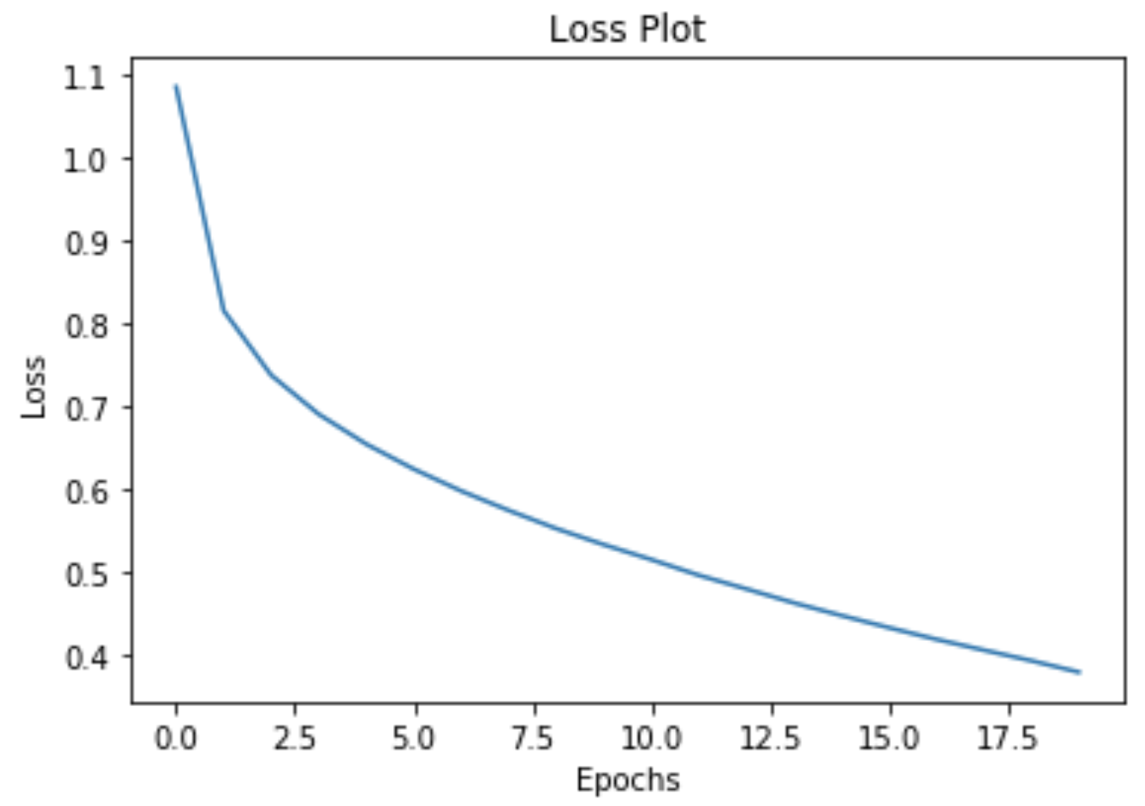
Training the Model (5 of 5)
plt.plot(loss_plot)
plt.xlabel('Epochs')
plt.ylabel('Loss')
plt.title('Loss Plot')
plt.show()
Notes:
Image from output of tutorial

Slide 36
Questions
Why did epoch 1 take longer than the others?
What is “loss”?
How might the loss change from epoch to epoch?

Slide 37
Validating the Captions (1 of 4)
def evaluate(image):
attention_plot = np.zeros((max_length, attention_features_shape))
hidden = decoder.reset_state(batch_size=1)
temp_input = tf.expand_dims(load_image(image)[0], 0)
img_tensor_val = image_features_extract_model(temp_input)
img_tensor_val = tf.reshape(img_tensor_val,
(img_tensor_val.shape[0], -1,
img_tensor_val.shape[3]))
features = encoder(img_tensor_val)
dec_input = tf.expand_dims([tokenizer.word_index['<start>']], 0)
result = []
Notes:
The evaluate function is similar to the training loop, except you don't use teacher forcing here. The input to the decoder at each time step is its previous predictions along with the hidden state and the encoder output.
And then the function stores the attention weights for every time step.

Slide 38
Validating the Captions (2 of 4)
for i in range(max_length):
predictions, hidden, attention_weights = decoder(dec_input,
Features, hidden)
attention_plot[i] = tf.reshape(attention_weights, (-1, )).numpy()
predicted_id = tf.argmax(predictions[0]).numpy()
result.append(tokenizer.index_word[predicted_id])
if tokenizer.index_word[predicted_id] == '<end>':
return result, attention_plot
dec_input = tf.expand_dims([predicted_id], 0)
attention_plot = attention_plot[:len(result), :]
return result, attention_plot
Notes:
The function stops predicting when the model predicts the end token.
And then the function stores the attention weights for every time step.

Slide 39
Validating the Captions (3 of 4)
def plot_attention(image, result, attention_plot):
temp_image = np.array(Image.open(image))
fig = plt.figure(figsize=(10, 10))
len_result = len(result)
for l in range(len_result):
temp_att = np.resize(attention_plot[l], (8, 8))
ax = fig.add_subplot(len_result//2, len_result//2, l+1)
ax.set_title(result[l])
img = ax.imshow(temp_image)
ax.imshow(temp_att, cmap='gray', alpha=0.6, extent=img.get_extent())
plt.tight_layout()
plt.show()
Notes:
Output the annotated image to show where the model's attention is.

Slide 40
Validating the Captions (4 of 4)
rid = np.random.randint(0, len(img_name_val))
image = img_name_val[rid]
real_caption = ' '.join([tokenizer.index_word[i]
for i in cap_val[rid] if i not in [0]])
result, attention_plot = evaluate(image)
print ('Real Caption:', real_caption)
print ('Prediction Caption:', ' '.join(result))
plot_attention(image, result, attention_plot)
Image.open(img_name_val[rid])
Notes:
Select an image at random and create the caption out of the words.

Slide 41
Next Steps
Try this model on a new image from the Internet
Train the model on a different dataset.
Language Translation with Attention codelab.
Notes:
The method allows you to caption your own images (hosted and public) with the model we just trained. It was trained on a relatively small amount of data, and your images may be different from the training data (so be prepared for weird results!).
This method will not overwrite the image. If you change the image you can change the name 'image' in line 4 of the cell to something else.

